Slide 1

B.Tech Project Final Evaluation, VIIIth Sem
Project Title---- Fake Product Detection using Blockchain
Presented by:-
Mukul ., 2019664038
Om Vaibhav, 2019007923
Abhishek Sharma, 2019551388
Under the Supervision of:- Dr. Vivek Sharma
( Associate Professor)
Sharda University, Gr. Noida
DEPARTMENT OF COMPUTER SCIENCE & ENGINEERING
SCHOOL OF ENGINEERING AND TECHNOLOGY
May, 2023
1

Slide 2
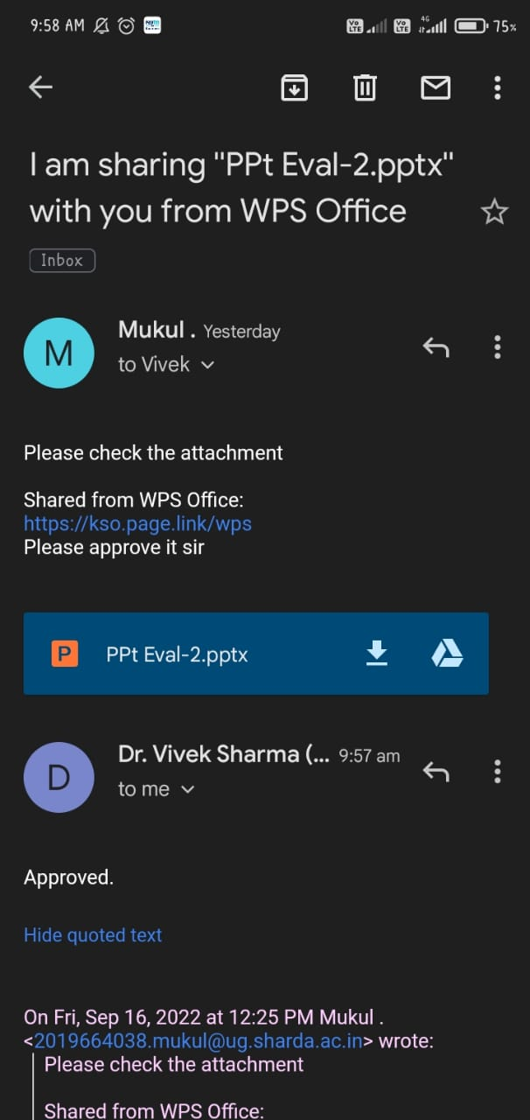
Approval from guide for the evaluation

Slide 3
Contents of the Presentation: 1) Work Load Distribution and Project Planning 2) Introduction 3) Blockchain in Fake Product Detection 4) Problem Statement 5) Objective 6) Existing System 7) Proposed System 8) Advantages 9) Data Flow Diagram 10) List of Modules 11) Conclusion

Slide 4
Work load distribution and Project planning
S No. | Team Members | Contact Number | System Id | Role to be assigned
1. | Mukul . | 9990779486 | 2019669038 | Coding and concerned Research, Product Design
2. | Om Vaibhav | 8882267126 | 2019007923 | Documentation and research work, coding
3. | Abhishek Sharma | 9667671038 | 2019551388 | Testing and coding , Product review

Slide 5
Introduction to the Project
Counterfeiting and duplication are always risk considerations in the global development of a product or technology, and they can harm the company's name, revenue, and consumer health. In the supply chain, there are a plethora of items.
To determine whether the goods is genuine or counterfeit. Manufacturers are experiencing a major problem and significant losses as a result of counterfeit or fraudulent items. We can use blockchain technology to verify the product's authenticity.
Counterfeiting is a problem that blockchain technology helps to solve. It is more secure to use blockchain technology. Once the product is stored on the network, a hash code is generated for it, allowing all transaction records for the product and its present owner to be kept in one place as a chain is established for that product's transactions.
The blockchain will keep all transaction records in the form of blocks. We assign a produced QR code to a certain product in the suggested system, and the end customer can scan the QR code to acquire all information about that product. We can tell whether a product is genuine or not by scanning the QR code.

Slide 6
Blockchain in Fake Product Detection
Blockchain is a data storage system that makes it difficult or impossible to alter, hack, or defraud the system.
A blockchain is a computerized record of transactions that is duplicated and disseminated across the blockchain's full network of PC computers. Each block in the chain comprises several transactions, and whenever a new transaction takes place on the blockchain, a record of that transaction is added to the records of all participants.
Distributed Ledger Technology is a decentralized database that is administered by a large number of people (DLT). Blockchain is a type of distributed ledger technology in which transactions are recorded using a hash, which is an immutable cryptographic signature

Slide 7
Problem Statement
The global advancement of a product or innovation is always accompanied by risk considerations such as forging and duplication. Forging items can have a negative impact on the company's reputation as well as the client's health. The finding of a fake item is currently the most difficult test. Fake things have a huge negative impact on the business as well as the client's health. As a result, item designers are in for a huge setback.
Fake and counterfeit goods are a problem in India and other countries.

Slide 8
Objective
The objective of our project is to find whether a given product is fake or original using Blockchain Technology.
To ensure the transferability of real products throughout the supply chain, we propose a fully functional blockchain system to prevent product counterfeiting, for that we will create a web interface for the user to scan the information of the product through the product QR code.

Slide 9
Existing System
Existing system have use the OTP verification and current tracking system for product delivery.
In OTP verification, the process is time consuming and purely depend on single person for confirmation.
In tracking system, the admin can take all the control, so they can modify the data and also we need go for the third party for trust and making a security.
This system is time consuming and has a lot possibility to change the real products when it’s going to customer.

Slide 10
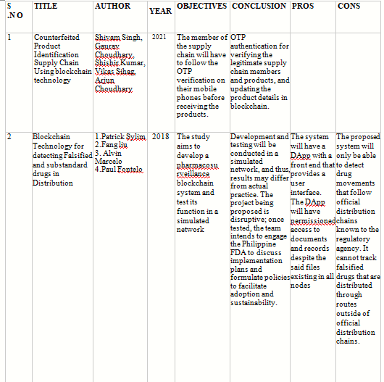

Slide 11
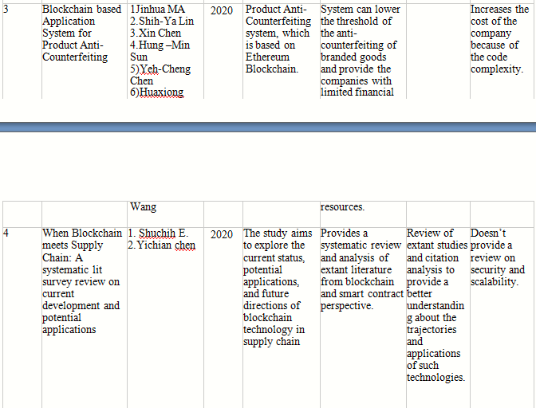

Slide 12
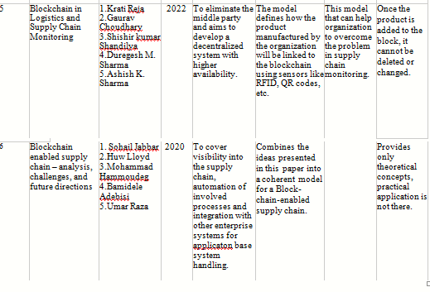

Slide 13
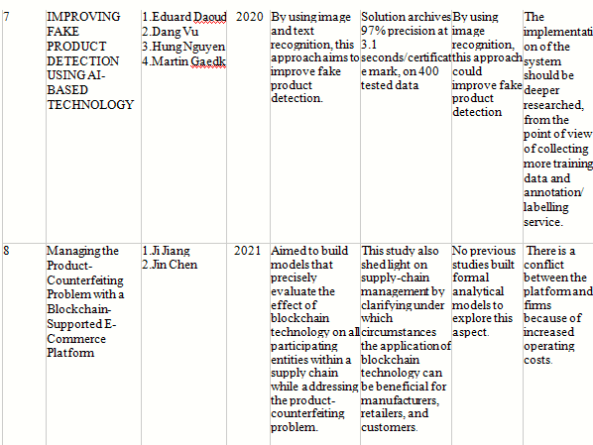

Slide 14
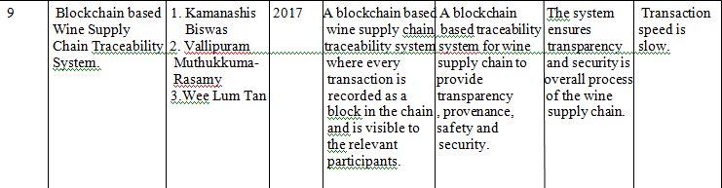
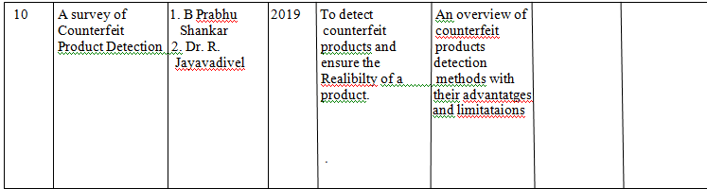

Slide 15
Proposed System
In the proposed system, the manufacturer and user both will be allowed to make some kind of transaction in the smart contract. The smart contract will be separate for each company and the company where they will get the features to add/modify product details, view listed products and transfer ownership to buyer. All the transactions made by company will directly update the smart contract and the transaction record will be moved to blockchain after verification.
For consumers or normal users, the features will be limited to transferring the ownership status of the products owned by them and also the ability to scan
the QR code or entering some unique product id to fetch the details of the product. When user scans for some product then the request will be made to blockchain which will retrieve the smart contract of the company that manufactured the
product and then return the details of the exact product. These requests are also in the form of transactions and hence they will also get recorded on the blockchain.

Slide 16
Hardware and Software
Hardware Requirements –
16GB RAM
2GB Graphic card
256GB SSB
i7 gen
Software Requirements –
Ethereum
Language – JavaScript, React Native, HTML, CSS
Metamask Wallet
Solidity – Smart Contracts

Slide 17
Advantages
Improve the security.
Make a trusted chain for privacy.
Its fully decentralized application.

Slide 18
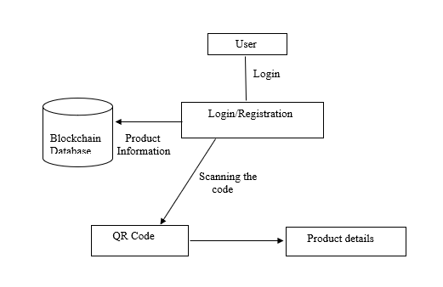
Data Flow Diagram

Slide 19
List of Modules
User Authorization
Product information Database
Product Authentication
Blockchain

Slide 20
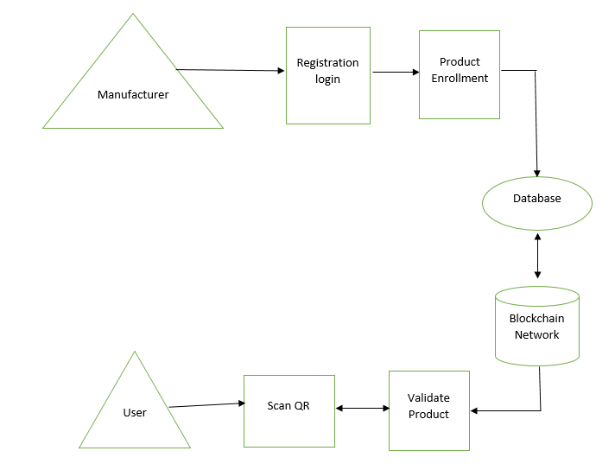
Result

Slide 21
Conclusion
Fake products are growing exponentially with the enormous amount
online. So, there is a strong need to detecting fake products and
blockchain technology is used to detect fake products. Furthermore,
the information is encoded into a QR code. Customers or users scan
the QR code and then they can detect the fake product. Digital
information of product can be stored in the form of blocks in
blockchain technology.

